Slide 1
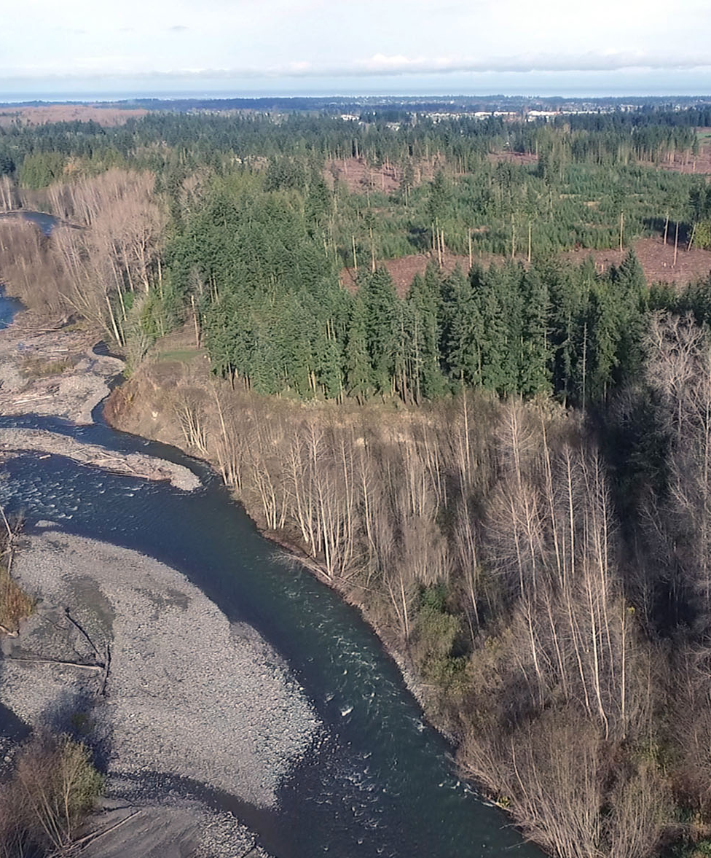
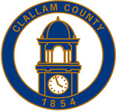
Dungeness Reservoir Construction: Building Climate Resilience in the Dungeness Community
FEMA HMGP Application
November 7, 2022

Slide 2
Project Summary
The proposed Dungeness Off-Channel Reservoir Project offers a water storage concept that has broad support among local and state resource managers, water users, state and federal legislators, the Jamestown S’Klallam Tribe, and other key stakeholders. The proposed project will construct a 1,600 acre-foot off-channel reservoir on a 319-acre parcel located near Sequim, WA.
Stream flows in the Dungeness River derive largely from the Olympic Mountains snowpack and decline throughout the summer as the snowpack melts typically reaching their lowest levels in Aug-Sept –the same time that human and salmon freshwater needs are at their greatest. During this annual period of low flow, local water right holders can withdraw as much as half of the river’s flow, which further reduces the amount of cool water and habitat available to migrating, spawning, and rearing ESA-listed fish and can contribute to fish stranding and upstream fish passage challenges as well as dangerously high water temperatures.
The Sequim area only receives about 16 inches of precipitation per year, similar to places like Los Angeles and the desert-like areas in eastern Washington, and is increasingly susceptible to drought as eight of the last twenty years – including four of the past eight years – in the area have been drought or dry years.

Slide 3
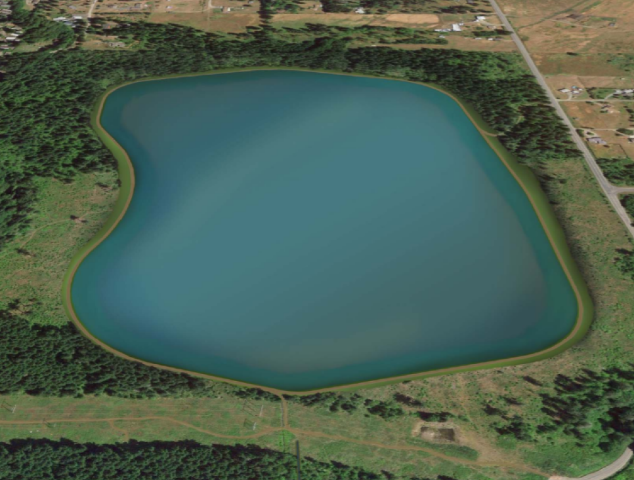
Project Summary Cont.
The Reservoir will collect and store water off-stream during winter and spring when Dungeness River flows are plentiful. This stored water will be used for aquifer recharge and for food production later in the year in place of water withdrawn directly from the river when flows are at their lowest. The result will be increased groundwater levels in the heavily tapped shallow aquifer; a stable, drought-resistant and climate-resilient water supply for communities and local agriculture; and 15 - 26.5 cfs of stream flow restored to the Dungeness River resulting in weighted usable habitat area increases of up to 35% for ESA-listed fish species.

Slide 4
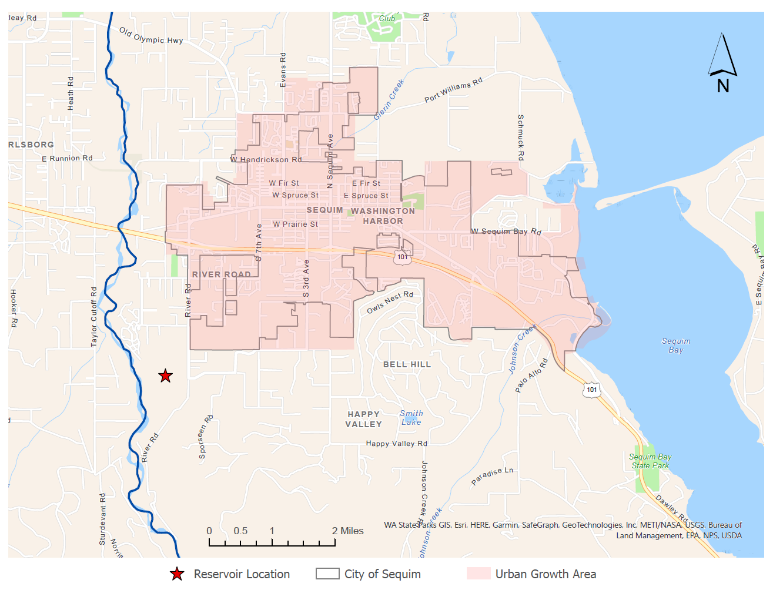
Project Location
Map

Slide 5
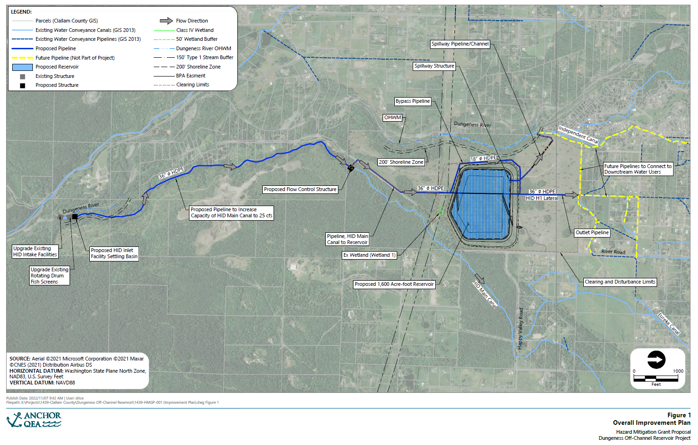
Project Overview Map

Slide 6
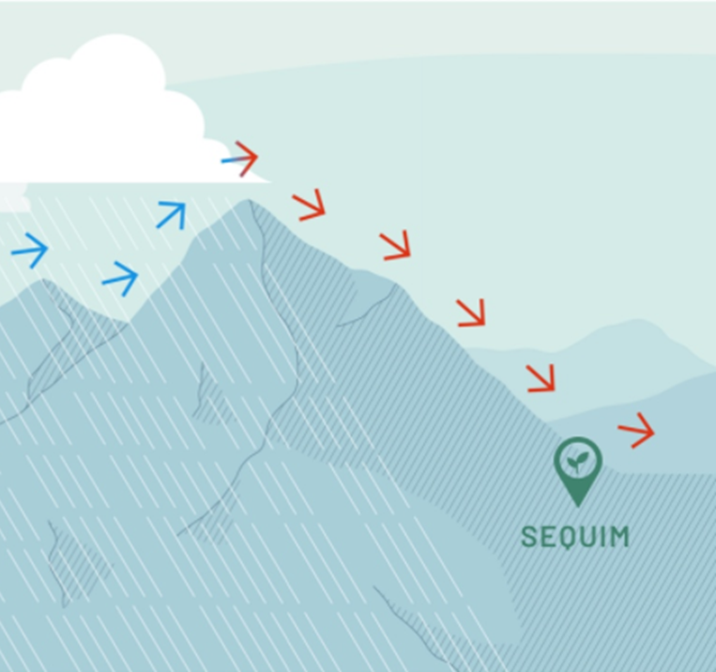
WATER SCARCITY
The Dungeness River basin is located in the Olympic Rain Shadow where the mountains act as a barrier that trap precipitation events from reaching the Sequim area. While other regions of the Olympic Peninsula receive the largest amounts of rainfall in the state, Sequim receives an annual rainfall of about 16 inches/year, about the same amount as Los Angeles, CA. In addition, due to the already dry climate, climate change and drought is projected to have the greatest impact on this area in the entire Puget Sound region. This unique environment can create potential for water conflict, and groups in the area have been working towards balanced solutions for decades to reduce conflict surrounding agricultural and domestic water demands and its impact on instream flows. The Reservoir would support those continued efforts that prioritize protecting and conserving river flows throughout the year to support salmonids and other wildlife, while also ensuring continued development and food production. The Reservoir project will reduce the potential for future water conflicts in the watershed and provide much needed drought and climate resiliency.
(Precipitation: 16 inches/year)

Slide 7

Benefits of reservoir
Aquifer Recharge
Drought Resilient & Climate Resilient Water Supply
Streamflow Restoration
Recreation
Long-Term Agriculture Viability

Slide 8

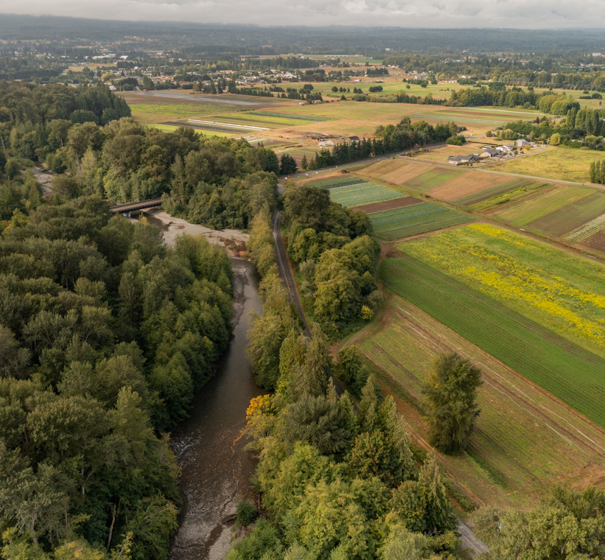
Aquifer Recharge
Stored water from the reservoir can be used for aquifer recharge to increase groundwater levels in the heavily tapped shallow aquifer as well as augment flows in local streams and generate additional mitigation credits for the Dungeness Water Exchange (a local water bank). Any new wells drilled in the Dungeness area require mitigation due to the Elwha-Dungeness Instream Flow Rule.

Slide 9

Climate Resilient Water Supply
Drought conditions have been prevalent in the area in four of the past eight years. This project will use water storage to provide a reliable climate-resilient water supply for drinking water supply/aquifer stability and the food system over time.
Late summer low flows are a primary limiting factor to habitat in the Dungeness River, which are projected to worsen as climate change is anticipated to move the system from snow/rain mixed precipitation to rain dominant with the peak flow shifting from late May to late January by the 2050s. The Reservoir will keep more water in the river during the late summer, fish critical period for ecologically and culturally important salmon, steelhead and bull trout.

Slide 10
DROUGHT in Washington state
(IncludinG the Dungeness WaTershed)
Drought Year | Type of Drought
2001 | Low winter precipitation
2003 | Dry summer
2005 | Warm winter temperatures
2009* | Low winter precipitation
2015 | Warm winter temperatures
2016* | Low winter precipitation
2019 | Low winter precipitation
2021 | Dry summer
*Dry year, no drought declaration

Slide 11
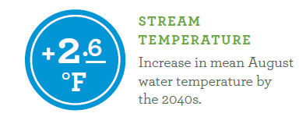
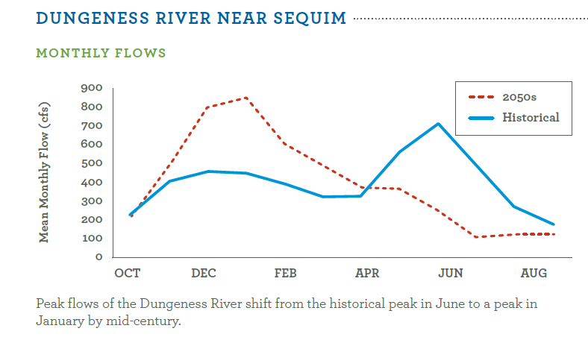
CLIMATE CHANGE
PROJECTIONS
Source: Mauger, G.S., J.H. Casola, H.A. Morgan, R.L. Strauch, B. Jones, B. Curry, T.M. Busch Isaksen, L. Whitely Binder, M.B. Krosby, and A.K. Snover, 2015. State of Knowledge: Climate Change in Puget Sound. Report prepared for the Puget Sound Partnership and the National Oceanic and Atmospheric Administration. Climate Impacts Group, University of Washington, Seattle.

Slide 12

Long term agriculture viability
The Off-channel Reservoir will secure access to water for agriculture during late watering season. This is critical for maintaining agriculture in the Dungeness Valley; this project ensures that fish can thrive and agriculture can continue.
Providing water security by utilizing stored waters offers an opportunity for farms in the area to continue to contribute to the more than $12 million Clallam County agricultural economy, retain the jobs associated with those farms, and maintain local food sources.

Slide 13

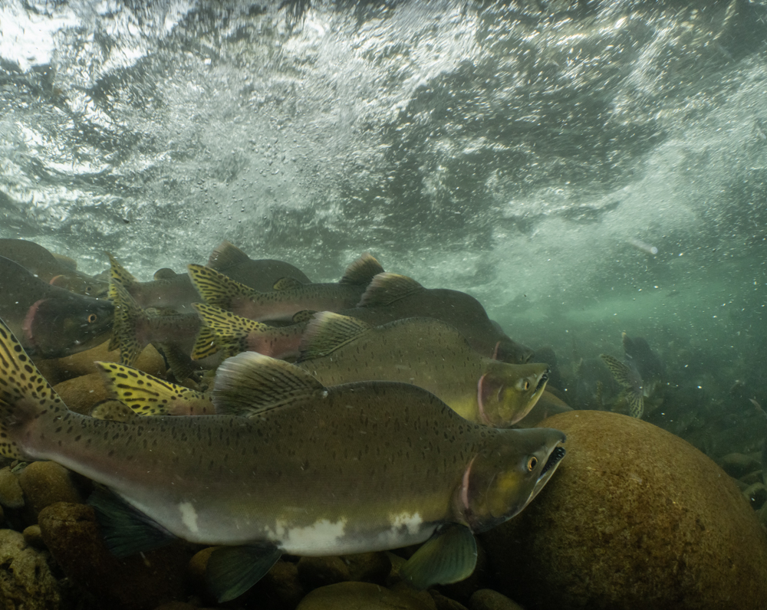
Streamflow restoration
The Off-channel Reservoir will:
Restore between 15 - 26.5 cfs of flow in the Dungeness River
Alleviate low stream flows and fish passage issues
Increase up to 35% of weighted usable habitat for ESA-listed species
Reduce water temperature for four ESA-listed salmon, steelhead and bull trout

Slide 14
DUNGENESS RIVER ESA LISTED FISH
SPECIES BY ESU | STATUS | EGGS PRESENT | JUVENILE PRESENT | ADULT PRESENT | POPULATION TREND
Chinook Puget Sound Dungeness River* | Threatened | x | x | x | Declining
Chum – Hood Canal, Strait of Juan de Fuca* | Threatened | x | x | x | Declining
Coho – Puget Sound/ Strait of Georgia | Species of Concern | x | x | x | Declining
Steelhead – Puget Sound, Dungeness River* | Threatened | x | x | x | Declining
Pink – Odd Year | Not Warranted | x | x | x | Stable
Bull Trout* | Threatened
*Endangered Species Act (ESA) listed species

Slide 15

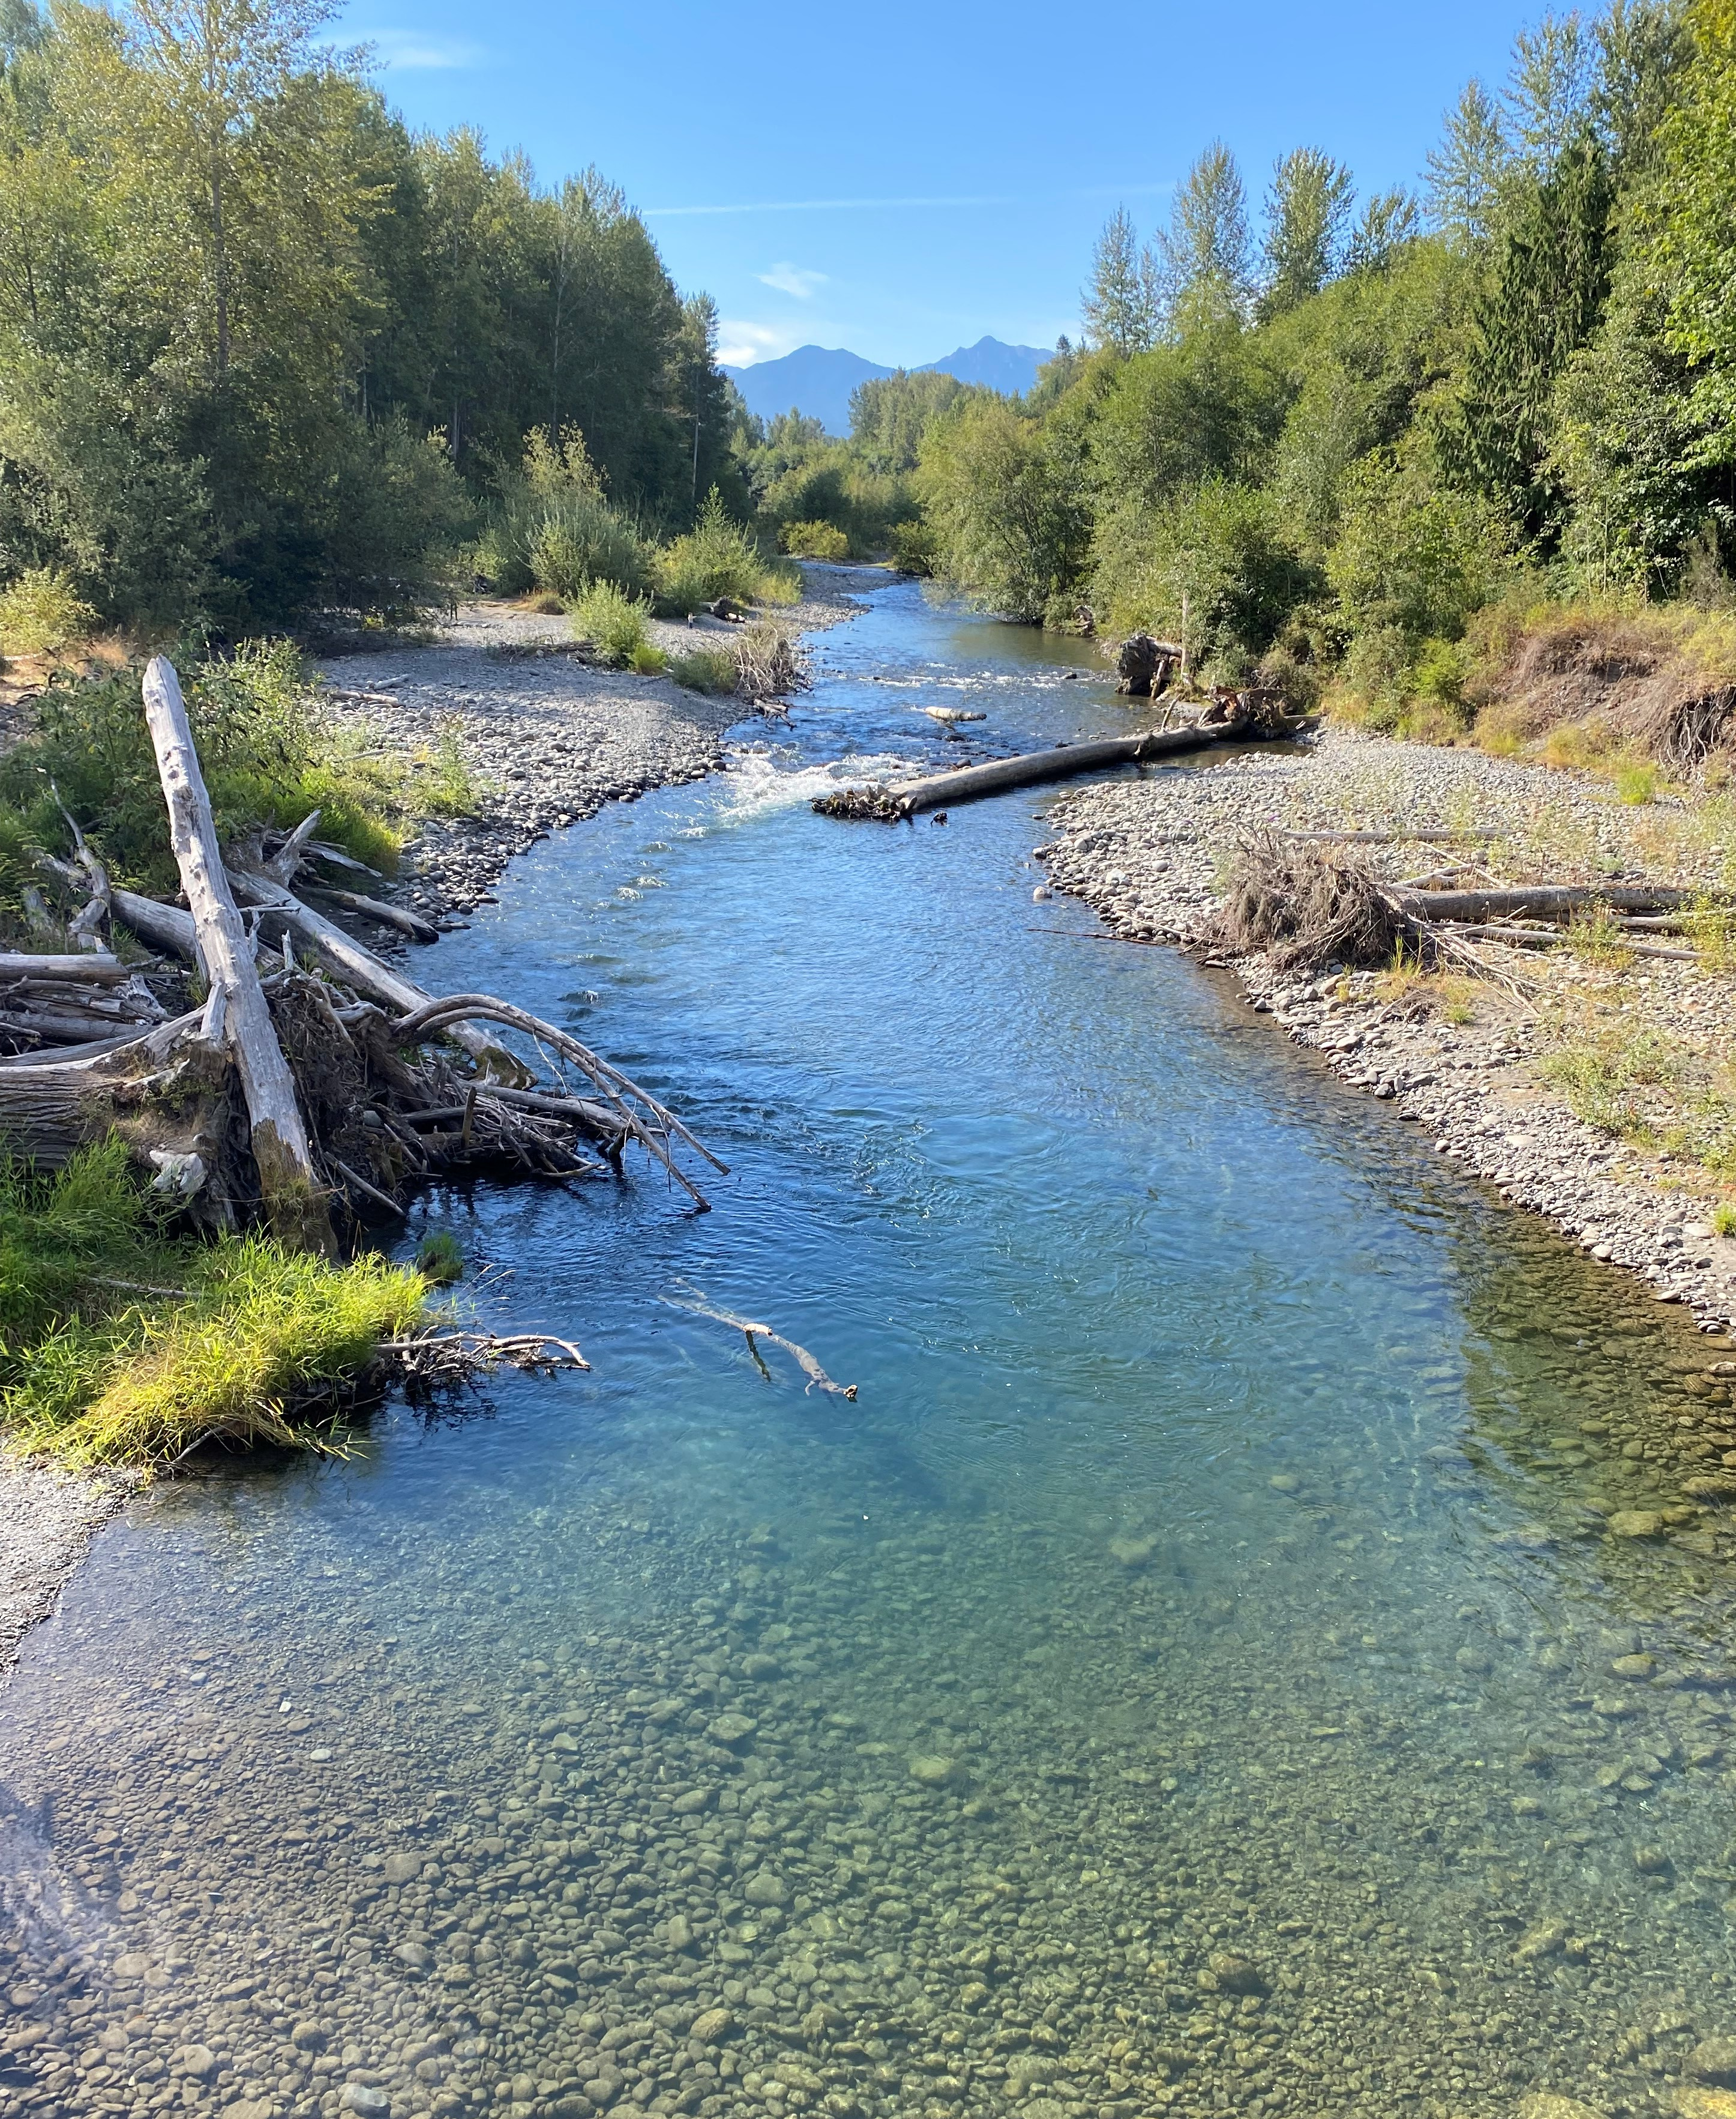
Recreation
The project site is currently owned by the WA Department of Natural Resources and will be owned and managed by Clallam County as a new 396 acre public park with hiking, biking, wildlife viewing, and river access opportunities. The park will provide aesthetic benefits for improved mental health and physical well-being. The Clallam County Parks, Fair, & Facilities Department and citizens support the addition of the new park.

Slide 16
The Reservoir will:
Increase groundwater levels in the shallow aquifer and augment stream flows through Aquifer Recharge.
Provide the community with a reliable climate resilient water supply for drinking water supply/aquifer stability and food production.
Restore the Dungeness River by alleviating low stream flows and fish passage issues, restoring habitat, and reducing water temperature.
Provide the community with a new public park with hiking, biking, wildlife viewing, and river access opportunities.
Support the continued viability of food production in the Dungeness basin by providing water security in the face of climate change and water availability concerns.

Slide 17

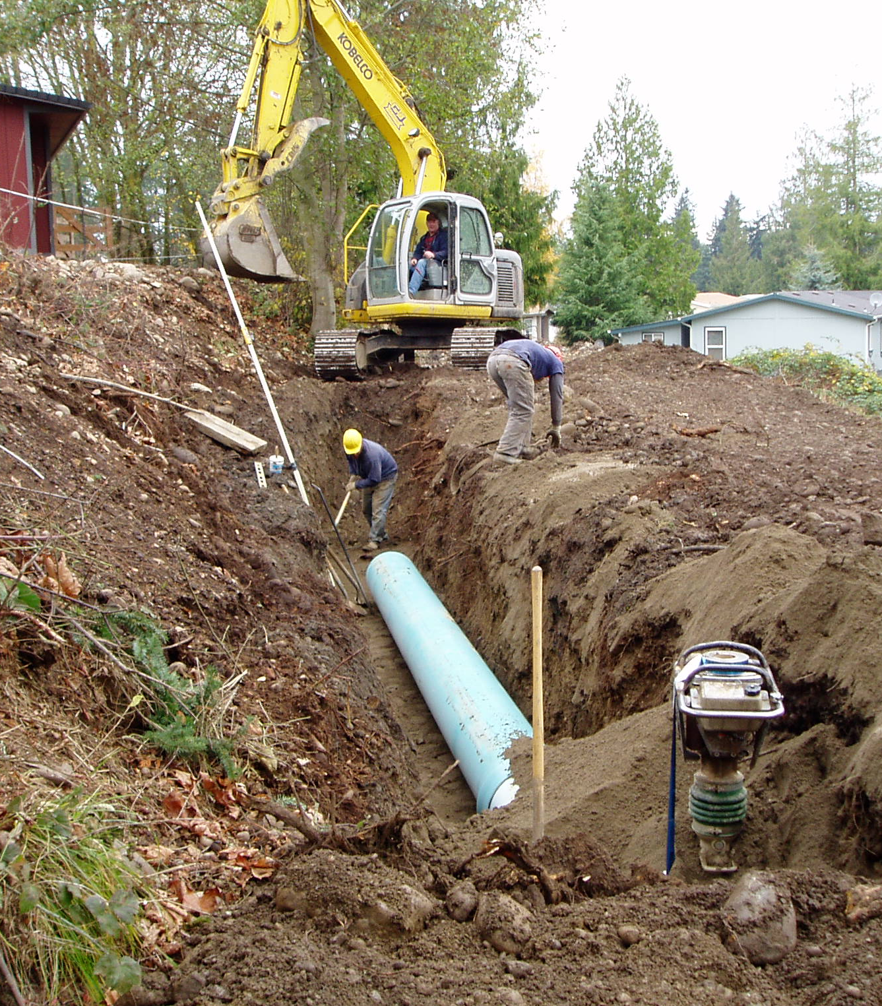
Construction
Total Construction Costs: $22,182,693
  Cost for Off-Channel Reservoir: $21,997,836
  Cost of Highland Irrigation Settling Basin: $184,857
Additional Project Costs:
Item | Cost
Land Acquisition and Appraisals | $2,520,000
Engineering Design and Permitting | $2,698,770
Project Management/Administration, Legal, etc. | $ 710,309
Construction Management (8%) | $1,774,615
Misc. (Public Outreach, Supplies, and Travel) | $ 68,300
Pre-award Costs | $ 32,000
Additional Project Costs | $ 6,029,379
Total Project Cost: $29,986,688

Slide 18
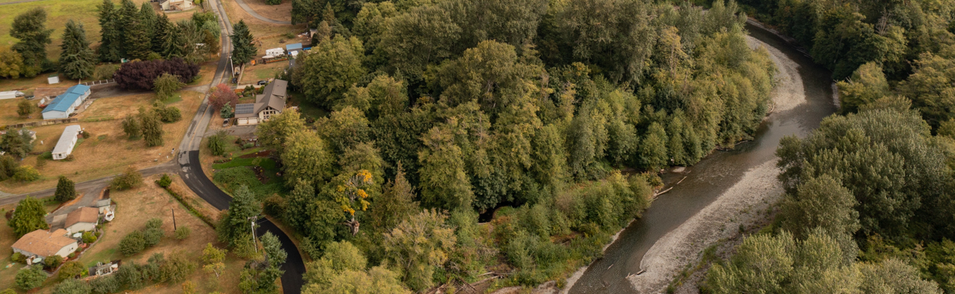
Secured Funding
Funding Source | Amount
WA Ecology Streamflow Restoration* | $7,968,553.00
WA Conservation Irrigation Efficiencies Grant Program | $54,136.34
Total | $8,022,689.34
*available match from WA Ecology 2019

Slide 19
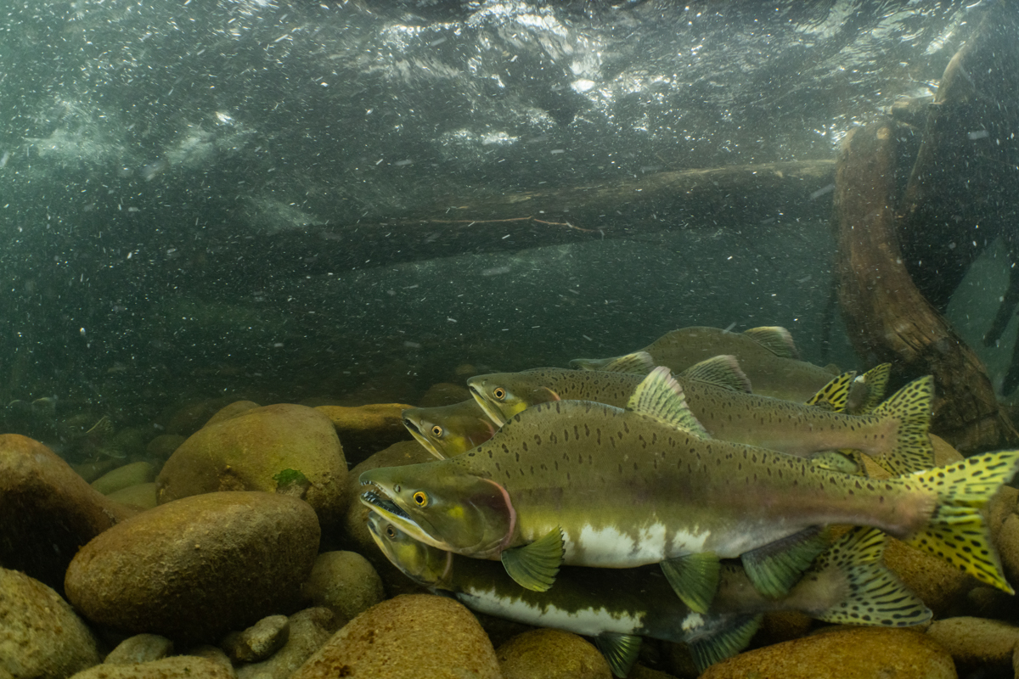
Benefit Cost Analysis
The BCA for the Dungeness Reservoir Off-channel Reservoir project is 1.91

Slide 20
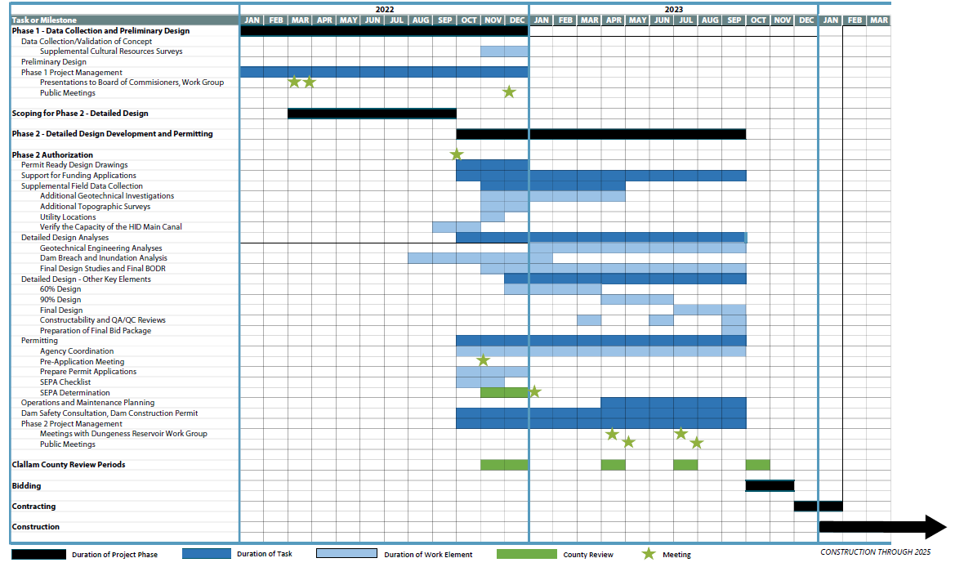
Dungeness Off-channel Reservoir PROJECT TIMELINE​

Slide 21

Dungeness off-channel reservoir
The project is an Infrastructure Project that incorporates a nature-based climate-resilient solution.
The project mitigates risk to the Community Lifeline: Food, Water, Shelter, and Agriculture
The project has mandatory state-wide building code adoption requirement (2018 version of International Building Code and International Residential Code). GMA compliant Comprehensive Plan and Critical Area Ordinance.
The project has a Building Code Effectiveness Grading Schedule (BCEGS) of 3

Slide 22
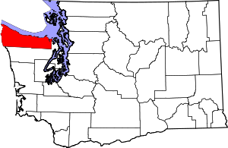
Population Impacted
The total population of Clallam County in 2020 was 77,155 and all will benefit from a healthy and climate resilient watershed and Dungeness River, a more climate-resilient local agricultural economy, and improved recreational opportunities. The number of people that live downgradient of the Reservoir is 11,812 (15.3% of the Clallam County total population) based on 2020 Census block data and these people will likely benefit most from the project.
WA

Slide 23
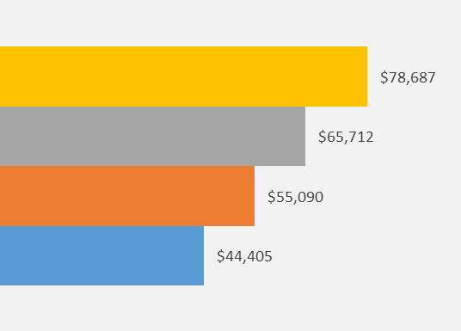
Project Impacts on
disadvantaged communities
The Dungeness Reservoir will benefit low income and minority populations. According to the US Census Bureau, the median household income of Clallam County from 2016-2020 (in 2020 dollars) was $55,090. This income is significantly lower than the Washington state ($78,687) and US ($65,712) median income. Additionally, income data retrieved from the American Community Survey indicates that within 2 miles down gradient of the Reservoir, there are about 2,512 people with a weighted median income of $44,405.13 – significantly below even the median household income of the County as a whole.
Median Household Income
WA state
US
Clallam County
Reservoir

Slide 24

Project Impacts on
disadvantaged communities Cont.
The population downgradient of the Reservoir is 14.0% non-white. Specifically, this project has significant positive benefits for the Native American population; 13% of the non-white population downgradient of the Reservoir is Native American.
One of the most culturally important species for the local Jamestown S'Klallam Tribe is salmon. The restoration of flows and fish habitat resulting from the construction of the Off-channel Dungeness Reservoir – as well as the climate resiliency for the freshwater and fish that the Reservoir will provide – will help to restore Dungeness River and local small stream salmon habitat, helping to increase the salmon populations that hold particular importance for Native Americans both locally and region-wide. The Jamestown S’Klallam Tribe has even passed a resolution stating that it “supports the Dungeness Off-Channel Reservoir as its highest priority to implement flow restoration, water storage and aquifer recharge because of its scale, location, cost/benefit and feasibility.”

Slide 25
Community Lifelines
The Dungeness Off-channel Reservoir project mitigates risk to the Community Lifeline: Food, Water, Shelter, and Agriculture.
The Off-channel Reservoir will help support the continued viability of agriculture in the Dungeness River Valley, particularly in the face of a increasing drought, changing climate, and resulting water availability concerns. Providing water security by utilizing stored water offers an opportunity for those farms to continue producing food and other products and contributing to the more than $12 million Clallam County agricultural economy and retain the jobs associated with those farms. The project will also augment the water supply for the community by implementing aquifer recharge. Additionally, there will be construction jobs that result from the development of this project and value added jobs resulting from accommodating the needs of the construction workers.

Slide 26
Multiple benefit Project
Positive impacts that the Dungeness Reservoir will provide to the community include a more climate-resilient local ecosystem, food system, and economy; a healthier and fuller local freshwater ecosystem including the Dungeness River, local streams, and aquifers; strengthened and more resilient farms and the livelihoods they support and food they provide; healthier salmonid populations that not only provide subsistence, economic, recreational, and cultural benefits for Tribal and other community members, but also serve as the key prey population for the endangered and beloved Southern Resident killer whales; and, finally, improved recreation opportunities from a healthier river as well as the local park that will surround the reservoir. We do not anticipate any negative effects from this project.
Aquifer Recharge
Climate Resilient Water Supply
Streamflow Restoration
Recreation
Long-Term Agriculture Viability

Slide 27
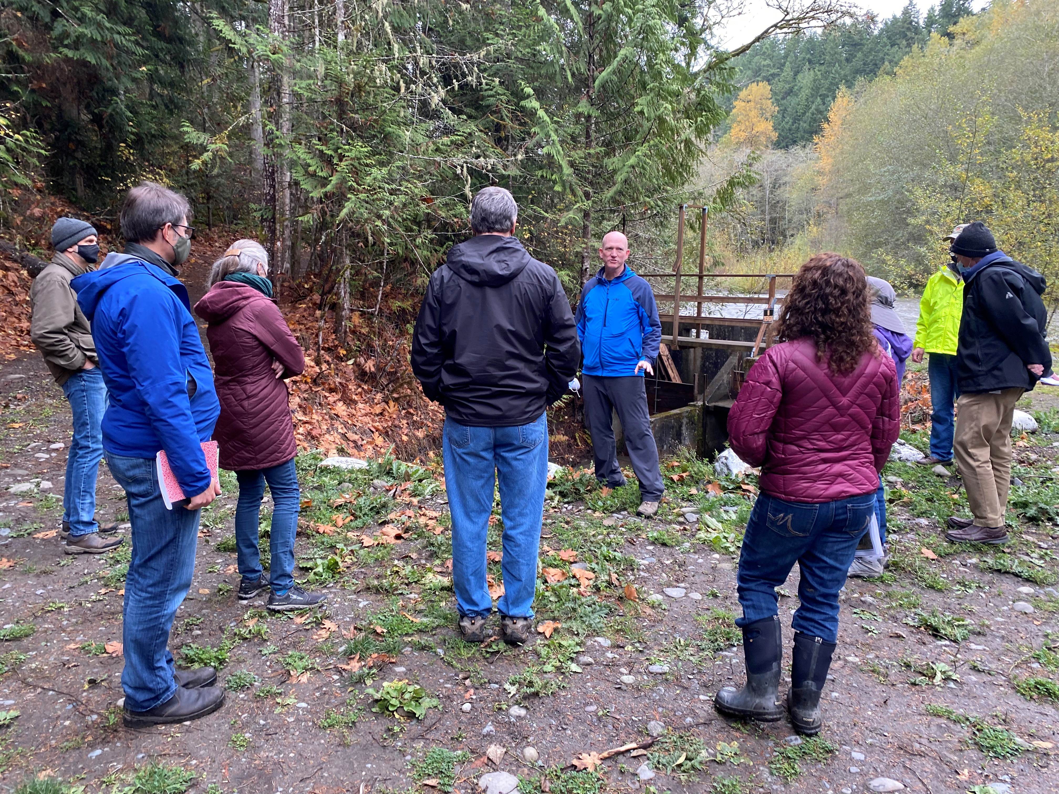
Collaboration
This project has broad support in Clallam County and aligns with local and regional recovery objectives.
A collaborative team, the Dungeness Off-channel Reservoir Work Group (DRWG), has convened since 2014 to discuss project components. Members include: Clallam County, Clallam Conservation District, Dungeness Water Users Association, Jamestown S’Klallam Tribe, City of Sequim, Washington Department of Ecology, Washington Department of Fish and Wildlife, and Washington Water Trust. Additional support has been voiced by Washington state and federal legislators.

Slide 28
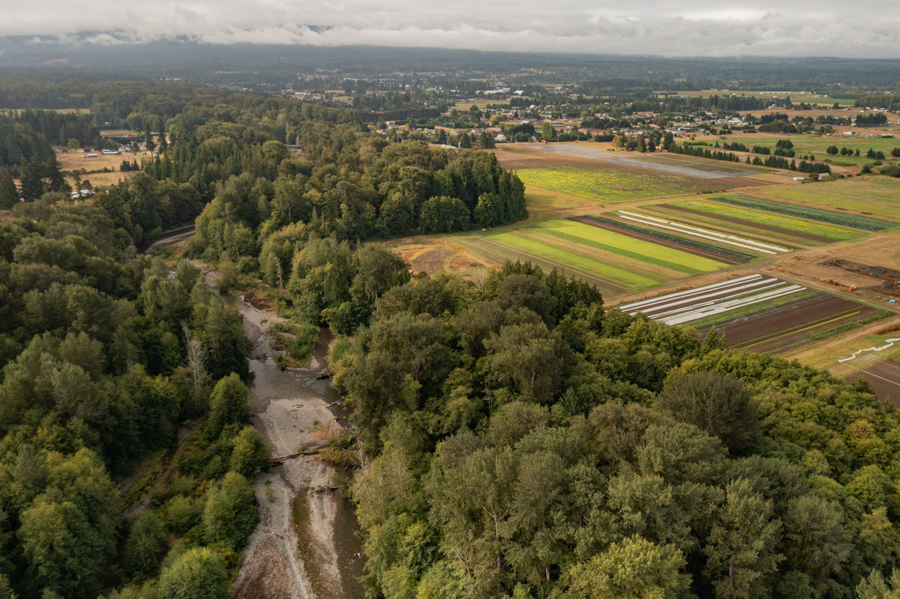
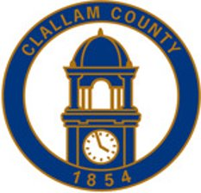
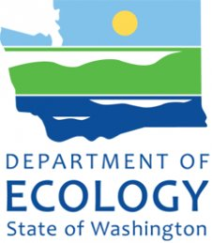
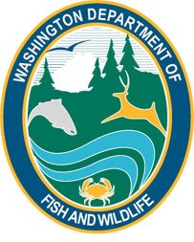

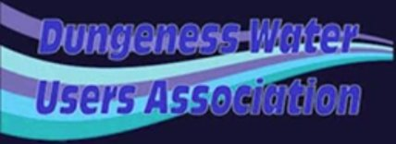

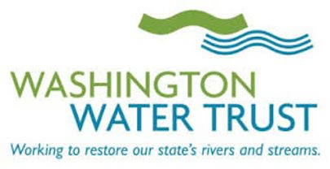

Project Partners

Slide 29
The Need for Innovative Solutions
On average the project area receives only 16 inches of rainfall per year, the driest place in western Washington. Snowpack is the only current form of water storage in the Dungeness basin and drought and climate change is jeopardizing this once-reliable Olympic Mountains snowpack. With a predicted significant decrease in future snowpack and a change from a snow and rain dominated climate to a rain dominated climate, the Dungeness Reservoir will replace snowpack storage with manmade storage to enable reliable and vital water supplies in the Dungeness basin for people, the local food system, and fish. The Reservoir will deliver a climate-resilient and innovative solution by storing early-season high-flow Dungeness River water for use for aquifer recharge and for agriculture during the late irrigation season as an alternative to river diversions when flows are critically low. Drought in the Dungeness has already made its impact felt in 4 of the past 8 years (2015, 2016, 2019, and 2021), providing us with empirical evidence on potential typical future conditions including the plummeting of river flows to 56 cfs in Aug. 2015, far below the minimum target flow (105 cfs) as well as the regulatory instream flow recommendation (180 cfs), and insufficient to support human water needs and anadromous fish. The UW Climate Impact Group projects that by the 2080s the average snowpack in Washington will decline by 56 to 70% and summer streamflows will decrease by 34 to 44% on average across the state. The late season flow that will remain instream thanks to the Reservoir will result in weighted usable habitat area (WUA) increases of up to 35% for ESA-listed fish and other wildlife.

Slide 30
FEMA-Approved hazard mitigation plan
The Dungeness Off-channel Reservoir is specifically called out in the Clallam County Multi-Jurisdictional Hazard Mitigation Plan to deal with the impacts of drought on agricultural, domestic, and municipal water supplies. Excerpts from the Clallam County Multi-Jurisdictional Hazard Mitigation Plan include:
4.5.12 Drought from the Clallam County Multi-Jurisdictional Hazard Mitigation Plan Vulnerability: Problems of domestic and municipal water supplies are historically corrected by building another reservoir. Future preparedness will depend on underground or reservoir water storage. The County’s vulnerability to drought has increased since 2010, as the demand has grown, and historic water supply shifts due to climate change and other factors.
Listed as CC15 and SQ04 in the plan. Agricultural: The linkage of meteorological (or hydrological) drought to impacts on agriculture, with focus on precipitation shortages, soil water deficits, reduced groundwater or reservoir levels, differences between actual and potential evapotranspiration, and other factors.
Hydrological: Associated with the effects of periods of precipitation shortfalls (including snowfall) on surface or subsurface water supply (i.e., streamflow, reservoir and lake levels, groundwater). Frequency and severity of hydrological drought may be defined on a watershed or river basin scale. While all droughts originate with a deficiency of precipitation, this definition is associated more closely with how the deficiency impacts the hydrologic system.
Table 6-5 2019-2025 Mitigation Implementation Plan CC15 Install off-channel reservoir adjacent to Dungeness River, to store high Dungeness River flows and storm flows for release later for aquifer recharge and irrigation purposes.

Slide 31
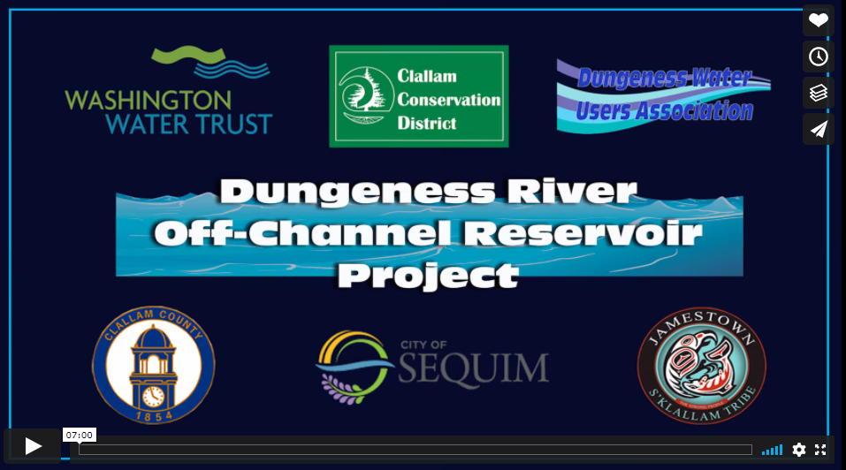
Project Film
Visit this link to view a film that highlights the needs and benefits of the Dungeness River Off-Channel Reservoir https://vimeo.com/203968263#t=NaNs
For more information about the project, please contact Carol L. Creasey (Reservoir Project Manager)
carol.creasey@clallamcountywa.gov
360-417-2424

