Slide 1
Dungeness Reservoir and Dam
Cost Vs Safety
Presentation by Paul R. Moore
November 9, 2022

Slide 2
Presentation Objectives
Express support for the reservoir
Convey a “red flag” concern that reservoir plans include an embankment (dam) approximately 30-35 feet tall
Highlight the possibility of an “extreme event” and the consequences should it occur
Enlist champions for a safer design with a shorter dam and less water stored above the ground

Slide 3
Public Benefit
There are good reasons for a reservoir:
Good for the river
Good for the salmon
Good for the people
Good for agriculture

Slide 4
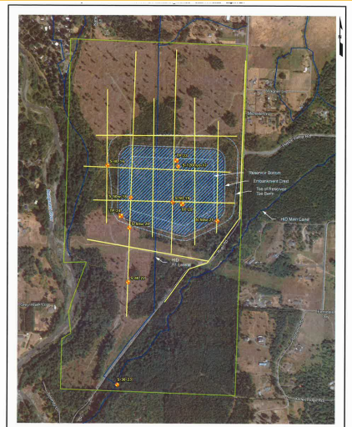
Reservoir Site
Paul’s House
Homes
Dungeness Meadows
Happy Valley Road
Approximate35 Foot Dam
1,600 Acre Feet of Water (about 521,000,000 gallons)
Spillway to River
Notes:
Diagram provided by Carol Creasey via email to Paul Moore on 8/3/2022, Excerpt from Site and Exploration Plan, July 2022

Slide 5
Proposed Design
Storage capacity of 1,591 acre-feet
Water surface area of 41.6 acres
Maximum water height of 50 feet
Approximate 30-35 foot dam constructed of excavated materials
Notes:
Preliminary Basis of Design Report 3-14-2022, Page 37; 30PCT Plans Pages 7 and 11. Height is estimated based on scale and elevations

Slide 6
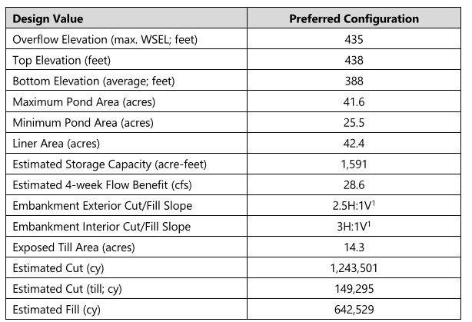
Proposed Design
Notes:
Preliminary Basis of Design Report 3-14-2022 Page 50

Slide 7
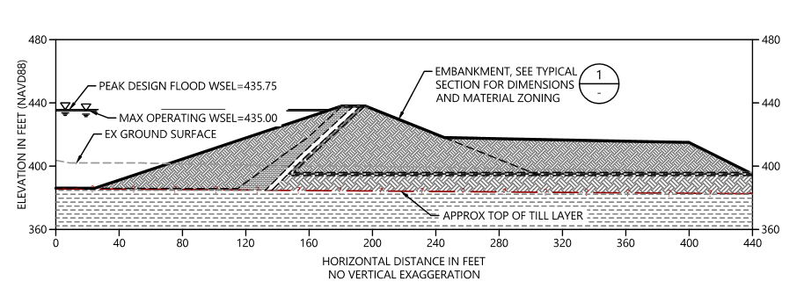
Embankment (Dam) Height
Notes:
30PCT Plans, Diagram C07, Page 11

Slide 8
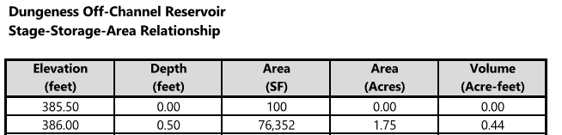

Reservoir Dimensions
Notes:
Preliminary Basis of Design Report 3-14-2022 , Appendix E

Slide 9
Major Design Considerations
The October, 2021 decision was made that the design should reduce cost by focusing on:
  Reducing the size of the liner
  Increasing the depth of excavation and height of the embankment
  Decreasing the footprint as much as possible
Notes:
Preliminary Basis of Design Report 3-14-2022 Pages 37, 47, 49

Slide 10
Let’s be Clear
We’re talking about a reservoir that
Holds over 500 million gallons of water, with
A 30-35 feet earthen dam with
A majority of that water above ground level
Notes:
Preliminary Basis of Design Report 3-14-2022 Page 37; and 30PCT Plans Pages 7 and 11. Height is estimated based on scale and elevations

Slide 11
Dam Material
An engineering review by PanGeo in December, 2020 concluded:
There may be insufficient excavated material to construct the dam, and if so
Remedial actions should be identified, such as deepening the excavation and lowering the berms
Notes:
Geotechnical Engineering Feasibility Report Review December 9, 2020, Page 10

Slide 12
Reservoir Lining
According to the current design document, The presence of a relatively shallow layer of low-permeability glacial till material may allow construction of the reservoir without a fabricated liner
The recommended preliminary design is to use material excavated at the south end of the proposed reservoir for the reservoir floor
Notes:
Preliminary Basis of Design Report, 3-14-2022, Page 106

Slide 13
Safety Regulations
The embankment must meet Washington Dam Safety Office design regulations for an “intermediate” or “large” (> 50 feet WSEL) dam
These regulations are designed to protect against “1 in a million” events such as
Earthquakes
Extreme storms
Notes:
Preliminary Basis of Design Report, 3-14-2022, Pages 55 and 164

Slide 14
Remote Chance?
“In floods and earthquakes the protection comes in the fact that the design event the facility must survive has an extremely remote chance of occurring.”
A “design event” is anything that
may cause the reservoir/dam to fail
According to the Dam Safety Office, the actual level of protection provided by a specified design may not be known with accuracy
Notes:
Washington State Department of Ecology, Dam Safety Guidelines Part IV, July, 1993, Pages 9 and 18

Slide 15
Extreme Events?
The Department of Dam Safety uses a statistical approach to justify a given embankment construction
“The Department recognizes that the majority of the engineering community has serious reservations about such an approach.”
The principal objection is that it typically has not afforded a "meaningful" treatment of "extreme events"
Notes:
Washington State Department of Ecology, Dam Safety Guidelines Part IV, July, 1993, Pages 13 and 14

Slide 16
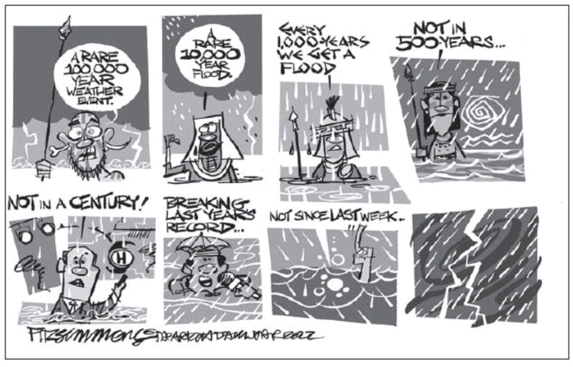
Extreme Events
Earthquakes and Storms!
Notes:
Cartoon published in the Peninsula Daily News 10/8/2022

Slide 17
Consequences of an “Extreme Event”
The most obvious consequence of an “Extreme Event” is the potential for dam failure causing flooding to the community with possible loss of life
Notes:
Washington State Department of Ecology, Dam Safety Guidelines Part IV, July, 1993, Page 8

Slide 18
Dam Failures
Dam failures occur by overtopping or breaches
Embankment overtopping remains the principal mechanism of earthquake induced failures and erosion can quickly follow
  Overtopping can also be caused by waves due to storms or dam component failures
Experience has shown that breaches in earthen dams are generally trapezoidal in shape and usually occur at the base of the dam
  It can start with a crack and small seepage!
Notes:
Washington State Department of Ecology, Dam Safety Guidelines, Technical Note 1 Dam Break Inundation Analysis and Downstream Hazard Classification

Slide 19
Peak Discharge from Dam Breach
Assumed peak discharge in the event of a dam breach for the revised reservoir design is:
19,500 Cubic Feet per Second
That’s about 146,000 gallons per second
That’s equivalent to releasing the amount of water in an Olympic-sized pool every 4.5 seconds
Notes:
Preliminary Basis of Design Report, 3-14-2022, Page 162 for 19,500 cubic feet per second reference. The next two bullet points were derived by math assuming 660,000 gallons in an olympic-sized pool

Slide 20
Loss of Life
The assumption of the “population at risk” from this reservoir in the event of a dam breach is:
150 people, with
A possible increase of 15 people over the lifespan of the dam
Notes:
Preliminary Basis of Design Report, 3-14-2022, Page 162

Slide 21
How can we lessen the risk?
The consequences of a dam breach are proportional to
Dam height; and
Reservoir size and dimensions
These influence:
Water volume released; and
Water velocity
Notes:
Washington State Department of Ecology, Dam Safety Guidelines, Technical Note 1 Dam Break Inundation Analysis and Downstream Hazard Classification

Slide 22
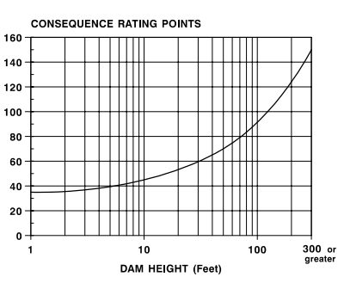
Importance of Dam Height
Notes:
Washington State Department of Ecology Dam Safety Guidelines Technical Note 2, July, 1992, Page 8

Slide 23
Embankment (Dam) Stability
The safety regulations say:
The development of a suitable embankment does not end with numerical analysis that the dam exceeds some minimum target stability parameter
It is an on-going, "cradle to grave" endeavor spanning
  Site investigation
  Design
  Construction
  Monitoring and maintenance of it in service
Notes:
Washington State Department of Ecology, Dam Safety Guidelines Part IV, July, 1993, Page 14

Slide 24
Cost
Back in 2016, the cost estimate for the original design was about $28 million
Costs for the current proposed reservoir design is approximately $33.6 million if a fabricated liner is not needed (excluding management cost),
Or approximately $35.0 million if the liner is needed (excluding management costs)
What price do we put on public safety?
Notes:
2016 cost is from Executive Summary and Project Proposal, January 2016, Page 15 and the Revised Reservoir costs are from Preliminary Basis of Design Report, 3-14-2022, Page 84

Slide 25
Summary
Dam height is a major factor determining the consequences if there is a dam failure
The proposed reservoir design focuses on cost
Extreme events happen and cannot be predicted
Safety, not cost, should drive the reservoir design – dig a deeper hole!

Slide 26
Public Input -- Really?
Will public meetings (“Open House”) simply be a “check the box” requirement meant to present rather than discuss?
Neighbors have not been included in project planning
What proactive steps can we take?

Slide 27
Thank you for your support!
Your continued support for the reservoir is requested to be contingent upon:
A design with a water level below ground as much as possible
Neighbors being involved as stakeholders

Slide 28
Information Resources
Current draft design information and other documents are posted at:
Riverroadreservoir.com
Comments/Questions:
info@riverroadreservoir.com

